Slide 1
Convex hull project
Group 3 Simon Konzett, Jérôme Hue, Thomas Fromherz, Melvin John

Slide 2
Sequential implementation
quickhull(…)
-points_on_hull(…)
-quickhull_split(…)
--functions(…)
--quickhull_split(…)
---functions(…)
--quickhull_split(…)
---functions(…)
-quickhull_split(…)
--functions(…)
--quickhull_split(…)
---functions(…)
--quickhull_split(…)
---functions(…)

Slide 3
Sequential implementation

Slide 4
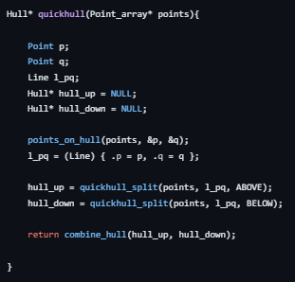
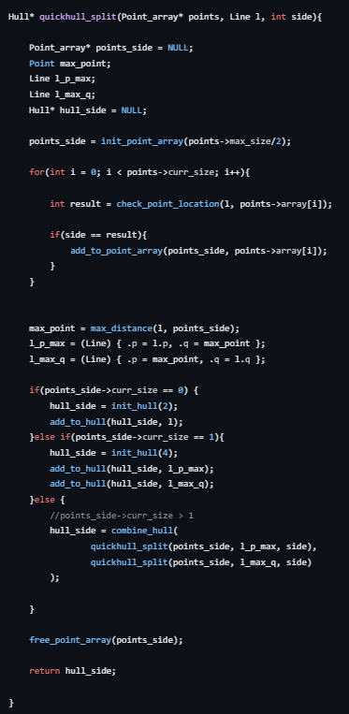
Parallel implementation
minmax(…)
split(…)
max_distance(…)

Slide 5
Parallel implementation – Memory Transfers
CPU Memory
GPU Memory

Slide 6
Parallel implementation – Memory Transfers
CPU Memory
GPU Memory

Slide 7
Parallel implementation – Memory Transfers
sizes of arrays
sizes of arrays
CPU Memory
GPU Memory

Slide 8
Parallel implementation – MinMax

Slide 9
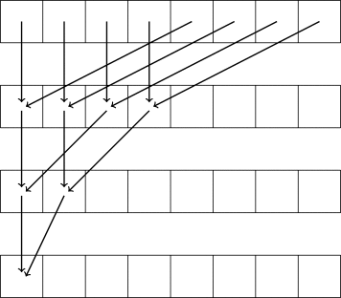
Parallel implementation – MinMax
parallel reduction in every block: shared memory
if only one block: done
otherwise repeat with output of each block

Slide 10

Parallel implementation – MinMax Thrust

Slide 11
Parallel implementation – Max Distance
implementation same as for MinMax
use normal distance for comparison

Slide 12

Parallel implementation – Max Distance Thrust

Slide 13
Parallel implementation - SPLIT

Slide 14
Parallel implementation - SPLIT

Slide 15
Parallel implementation - SPLIT
1
0
0
1
1
0
0
0
1
set above bits
0
1
1
1
2
3
3
3
3
prefix above bits
0
1
1
0
0
1
1
1
0
set below bits
0
0
1
2
2
2
3
4
4
prefix below bits
ABOVE
BELOW

Slide 16
Parallel implementation - SPLIT
0
1
2
3
0
1
2
3
4
ABOVE
BELOW

Slide 17

Parallel implementation – SPLIT Thrust

Slide 18
Parallel implementation - Challenges
Proofing correctness
Debugging
Precision

Slide 19
Results / Experiments
validation
quickhull
minmax, max (distance), prescan, split
method
compare parallel and sequential implementation
sampling

Slide 20
Validation
subfunctions
parallel vs sequential implementation ✓
quickhull
parallel vs sequential implementation ✓
random points in a square ✓
random points on a circle ✗

Slide 21
Results / Experiments
QuickHull performance
parallel vs sequential implementation
different setups: blocksize, memory model, thrust
points in a square, points on a circle

Slide 22
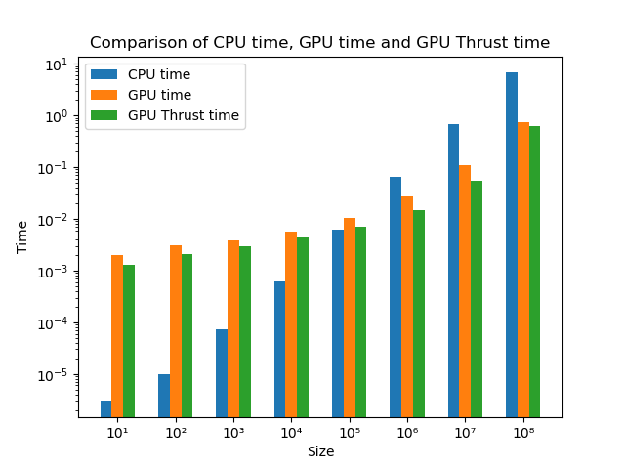
Performance vs input size
setup
BLOCKSIZE: 1024
PINNED MEMORY
random points in square
 | CPU | GPU | Thrust
time in sec | 6,71 | 0,74 | 0,64
speedup |  | 9,1 | 10,5

Slide 23
Performance vs input size
setup
BLOCKSIZE: 1024
PINNED MEMORY
random points in square
Number of points | 10⁴ | 10⁵ | 10⁶ | 10⁷ | 10⁸
GPU speedup | 0,1 | 0,7 | 1,8 | 6,2 | 9,1
Thrust speedup | 0,2 | 0,9 | 1,8 | 12,5 | 10,5

Slide 24
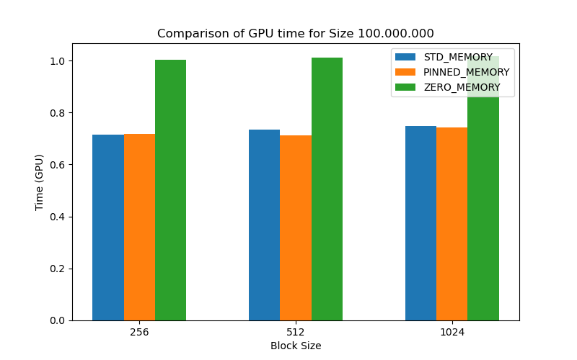
Performance vs memory model
setup
BLOCKSIZE: 256 to 1024
random points in square
observation
Zero memory does worse

Slide 25
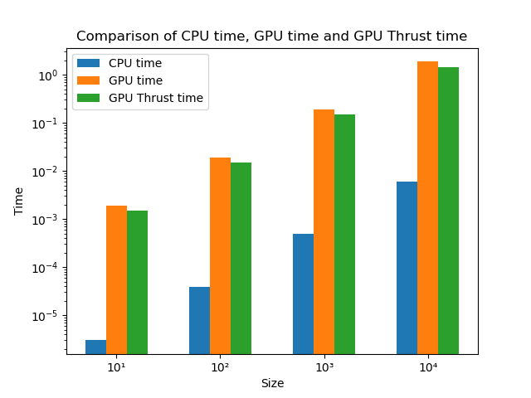
Random points on circle
setup
BLOCKSIZE: 1024
PINNED MEMORY
observation
no good scaling
memory allocation overhead
more parallelism necessary

Slide 26
Conclusions
what went well?
Subfunctions
Thrust
necessary improvements
floating point arithmetics
Parallelization of algorithm
Memory allocation management
Stream implementation

